Slide 1
Senty
Michael Gigiolio, Maxim Moghadam, Andrew Grillot, Stacy Hayes, Jonathan Bayer, and Juan Ferrer Peasley
Notes:
Michael

Slide 2
What is Senty
Corporate sentiment analysis software
Assesses public opinion of companies
Draws from twitter to determine corporate standing
Determines news media sentiment towards company
Allows users to view their most recent search
Notes:
Michael

Slide 3
Project objective:
Provide users with a way to determine how the public feels about a company at the current time
Notes:
Frankie

Slide 4
Principal Components
Sentiment Analysis
User Registration
Front End
Draw data from twitter and news media
Scan for bot accounts and ignore posts
Run sentiment analysis on received data
Give users ability to register and login
Catalogue user searches and interest
Display past searches to user to show how sentiment has changed since last search
Provide users with easily navigable website
Give clear access to important features
Deliver a visually appealing user experience
Notes:
Andrew- twitter, bot detection, and web scraping
Max, Stacy
-website not app
-option to create an account
-added functionality (search history & comparison to popular stocks)
-professional and user friendly

Slide 5




Tools Used
Python
Basic programming code
Creating functional features
5 Stars
Github
Compiling all work
Facilitating peer work/testing
3 Stars
MySQL
Store each sentiment analysis
Store data about twitter users
5 Stars
Flask
Python microframework
Login system
4 Stars
Notes:
Andrew

Slide 6




Tools Used
HTML
Website Markup
Interactive Forms
5 Stars
CSS
Website Style
Website Layout
5 Stars
Trello
Visualizing progress
Dictating workload
2 Stars
JQUERY/AJAX
Get/Post methods
2 Stars
Notes:
Stacy, Max
-instrumental in deploying our software
-provided us a lot of functionality while permitting creative license
-not very useful for our project through no fault of its own
-lots of other project management and communication tools (Slack, Gantt chart, group text)

Slide 7

Methodologies
Iterative
Agile
Gantt Chart
Allowed us to finish components portion by portion
Allowed for optimization before moving further
Paired well with Github
Emphasized teamwork and collaboration
Allowed easy response to circumstance
Many software iterations
Good pacing
Allowed cataloguing of timeframes
Too rigid
Emphasized personal tasks rather than collaborative
More or less unused due to changing specs
Notes:
Frankie

Slide 8
Product Execution

Slide 9
Challenges Encountered
Web Framework
Learning flask
Ensuring every element of the web framework is properly functioning and integrated
Login
Difficult to implement
Experimented with multiple languages
Required own database
Solved with effort
Pairing user data with profiles
Integration of multiple databases
Notes:
Max

Slide 10
Challenges Encountered
Bot Detection
Proper bot detection is very time consuming and requires a lot of data
Needed to cut corners in order to get the user’s request in a reasonable amount of time
Sentiment Analysis
Originally to be coupled with natural language processing
Scrapped, beyond our capabilities
Planned to display graph over time
Would require populating database first, scrapped
Removing spam that could weight scores
Implemented bot detection
Notes:
Jonathan

Slide 11
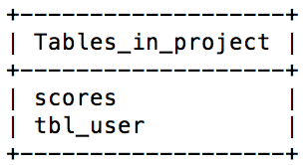
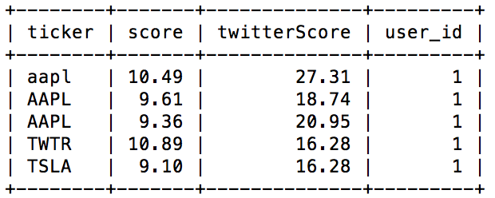
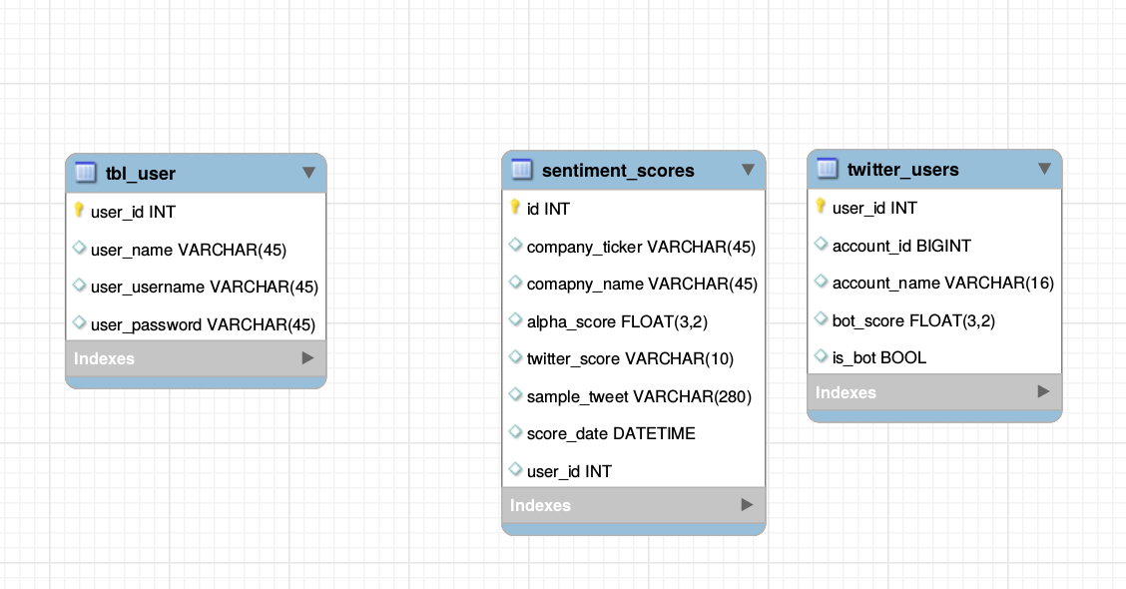
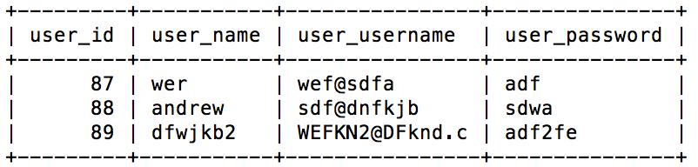
Database
scores- stockticker - sentimentscore - twitterscore - user_id
tbl_user- username - email - password
twitter_users

Slide 12
Testing Procedures
Automated Testing
Performing assertion tests
Confirming variable data falls within acceptable ranges
Verifying error handling
Ensuring proper website pathing
User Acceptance Testing
User testing website
Providing erroneous queries
Confirming bot detection
Demonstrating website intuitiveness
Ensuring home page text is accurate and informative
Notes:
Michael

